Slide 1
NYU Marron's
Urban Data Hackathon
Civic Analytics
PRESENTED BY Ajayrangan Kasturirangan

Slide 2
Plowing Snow vs Potholes

Slide 3
What’s wrong?
311 receives more than 60,000 service requests annually from concerned residents regarding roadway potholes that they want fixed.
Plowing snow from roads during the winter may have effects on the long term stability of roads depending on the construction quality leading to potholes.

Slide 4
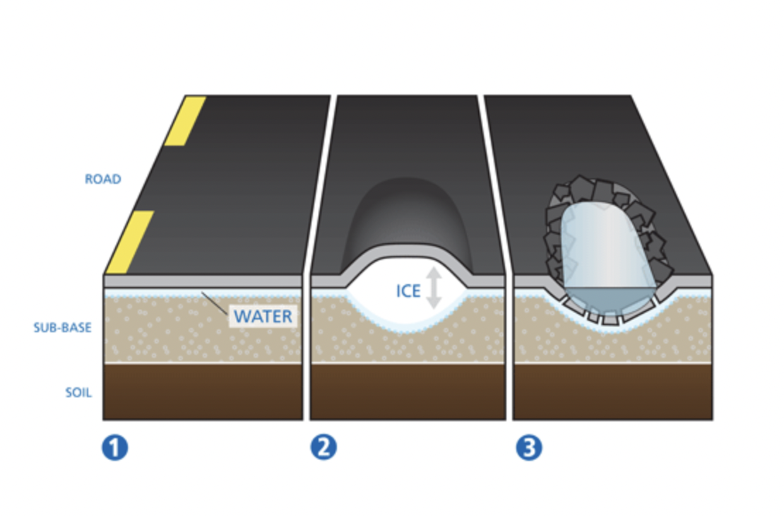
Science?
Source

Slide 5
Data
NYC Street Pothole Work Orders-Closed
DSNY - Snow Priority Designation
DSNY - PlowNYC Data

Slide 6
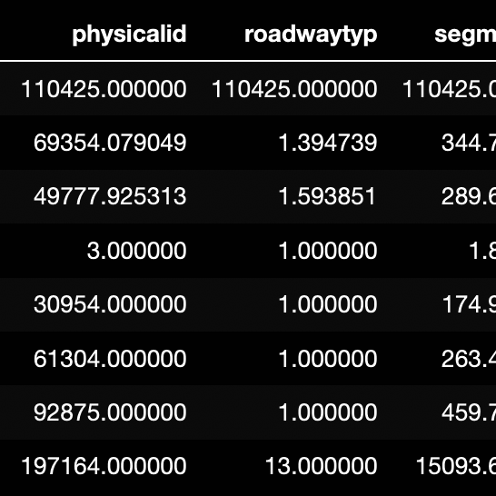
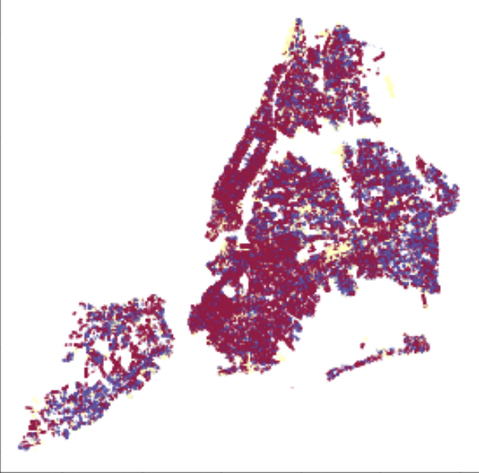
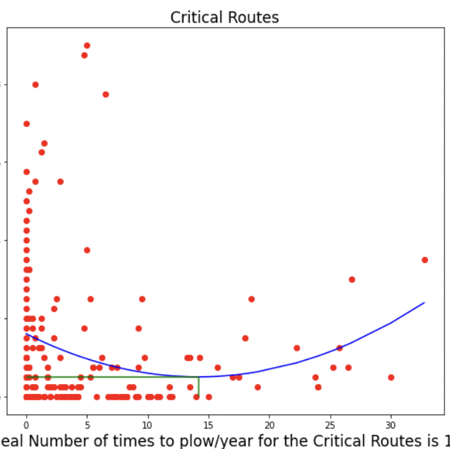
Methodology
Cleaning
Filtering out irrelevant data and ensuring data sanity. This includes identifying the ideal time frame in each dataset.
Exploring
Identifying the relevant and feasible subset of data for our analysis. This includes checking the different road types and snow priorities.
Analyzing
Analyzing the data by using optimization technique: Fitting a curve with the least square error to minimise number of potholes/year as a function of number of times the road was plowed.

Slide 7
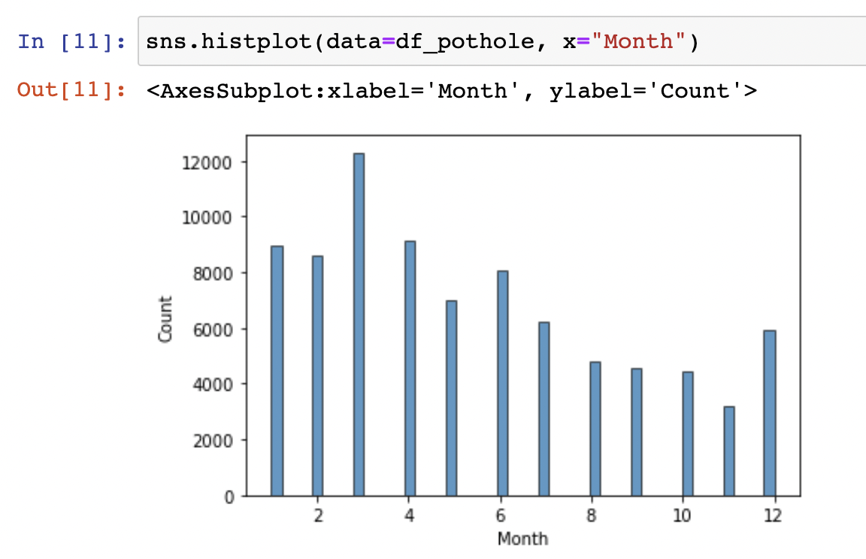

Slide 8
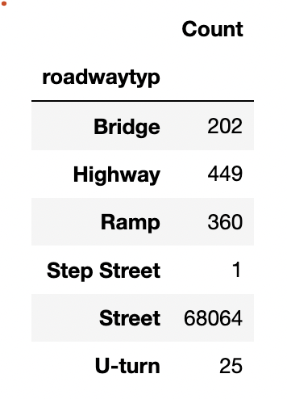
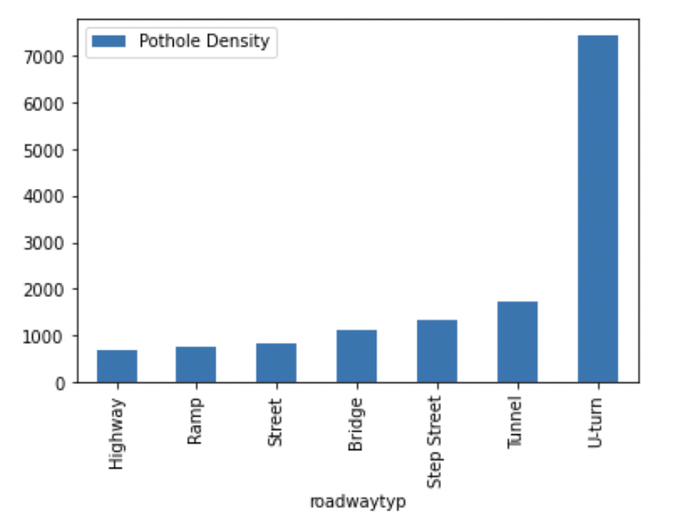

Slide 9
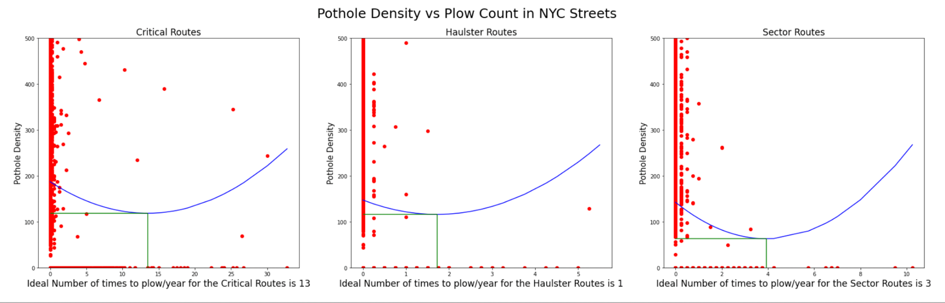
Result
-For larger samples, it is possible to fit a second degree polynomial and arrive at an ideal plow/year value.
-Deviating from this value could possibly result in an increase in number of potholes.
-Encouraging to further explore this hypothesis.

